Slide 1

Module 5
Tree-Based Models
Notes:
Guidelines
Use section headers to chunk content in your presentation.
Use the same style of section header throughout your presentation.
Keep your title to no more than 2 lines.

Slide 2

Ensembles
Notes:
Guidelines
Use a title slide at the beginning of your presentation. There are 9 variations of title slides to choose from.
If you will have a series of slideshows, we recommend using the same style of title slide for each presentation.
Keep your title to no more than 2 lines.
Do not change the font style or font size of the title or subtitle.

Slide 3
Findings on Decision Trees
Are easily overfit to the sample used
Model performance hard to judge using a single training and validation sample.
Decision Trees Have Low Bias, High Variance

Slide 4
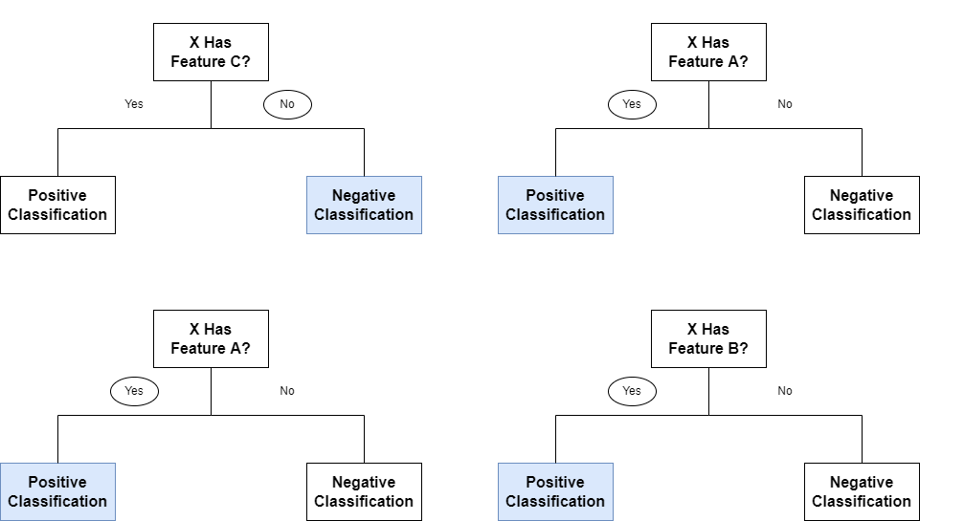
Ensemble Models
Combine the predictions from many different tree models.
Combining models should reduce the variance

Slide 5
Ensemble Models
Combine the predictions from many different tree models.
Combining models should reduce the variance

Slide 6
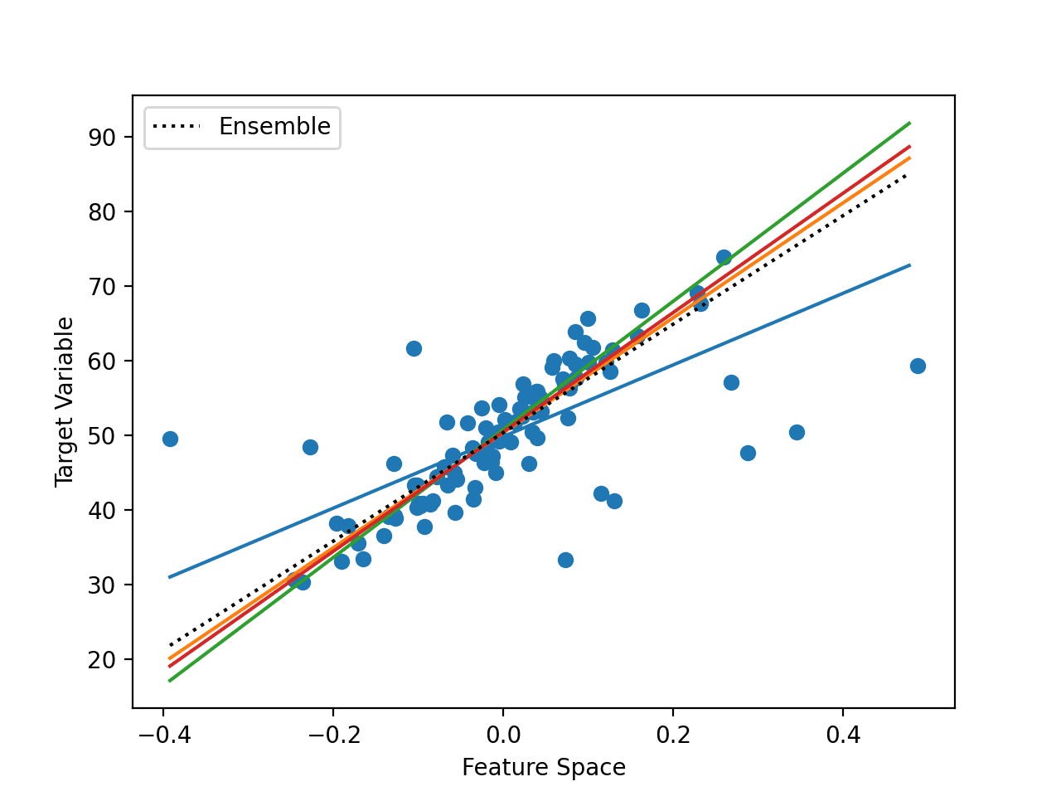
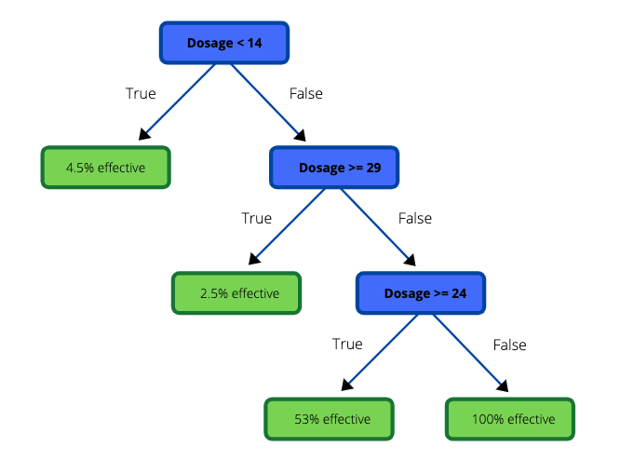
Ensemble Models
Combine the predictions from many different tree models.
Combining models should reduce the variance

Slide 7
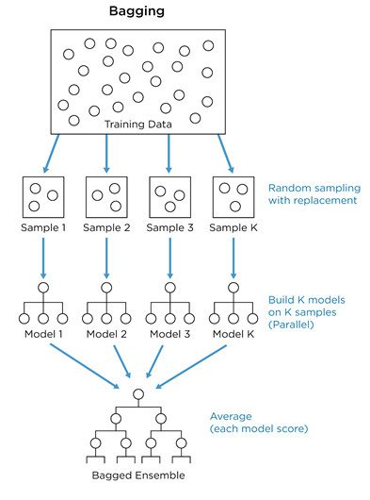
Bootstrap Aggregating (Bagging)
Bootstrapping means to randomly sample with replacement
A bootstrap sample is the same size as the original data set.

Slide 8
Bootstrap Aggregating (Bagging)
The out of bag (OOB) score can help estimate performance
Observations not selected in the bootstrap sample can be used to estimate the performance of the ensemble: Out-of-bag Performance.

Slide 9
Python
Notes:
Guidelines
Use a title slide at the beginning of your presentation. There are 9 variations of title slides to choose from.
If you will have a series of slideshows, we recommend using the same style of title slide for each presentation.
Keep your title to no more than 2 lines.
Do not change the font style or font size of the title or subtitle.

Slide 10
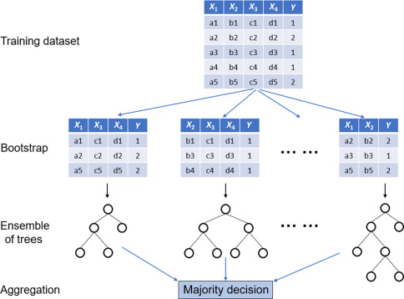
Random Forests
Bagging produces correlated predictions
We can improve Bagging by also sampling the variables

Slide 11
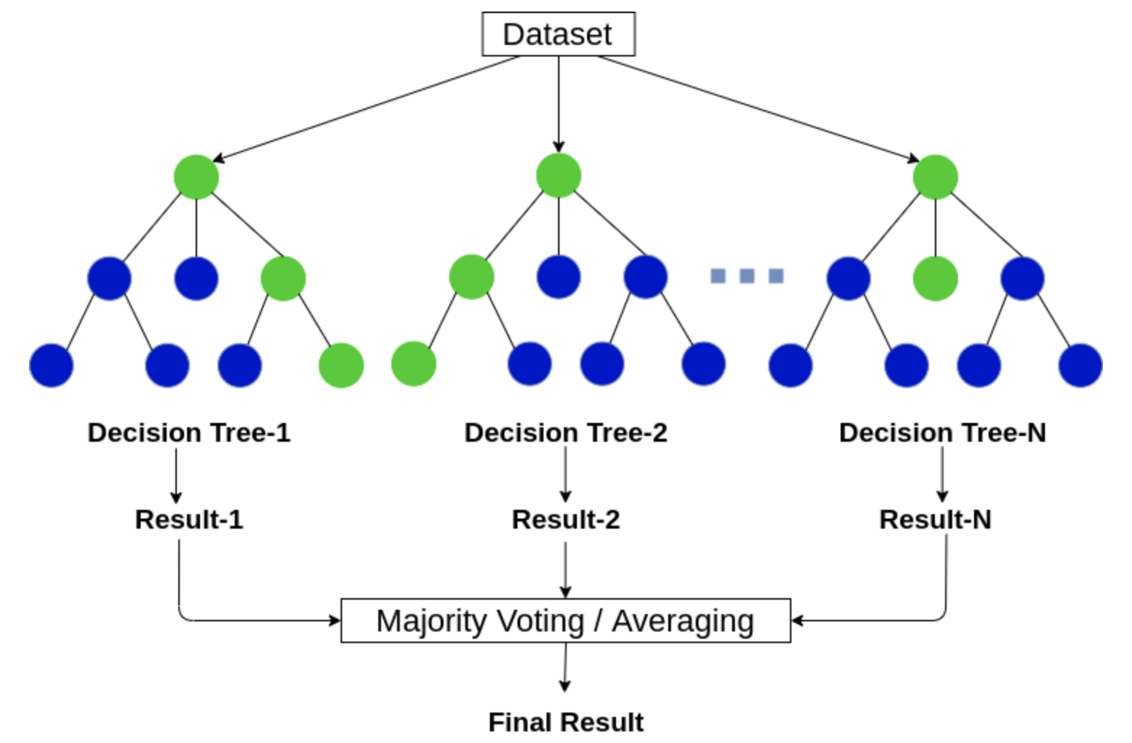
Random Forests
Bagging produces correlated predictions
We can improve Bagging by also sampling the variables

Slide 12
Python
Notes:
Guidelines
Use a title slide at the beginning of your presentation. There are 9 variations of title slides to choose from.
If you will have a series of slideshows, we recommend using the same style of title slide for each presentation.
Keep your title to no more than 2 lines.
Do not change the font style or font size of the title or subtitle.

Slide 13
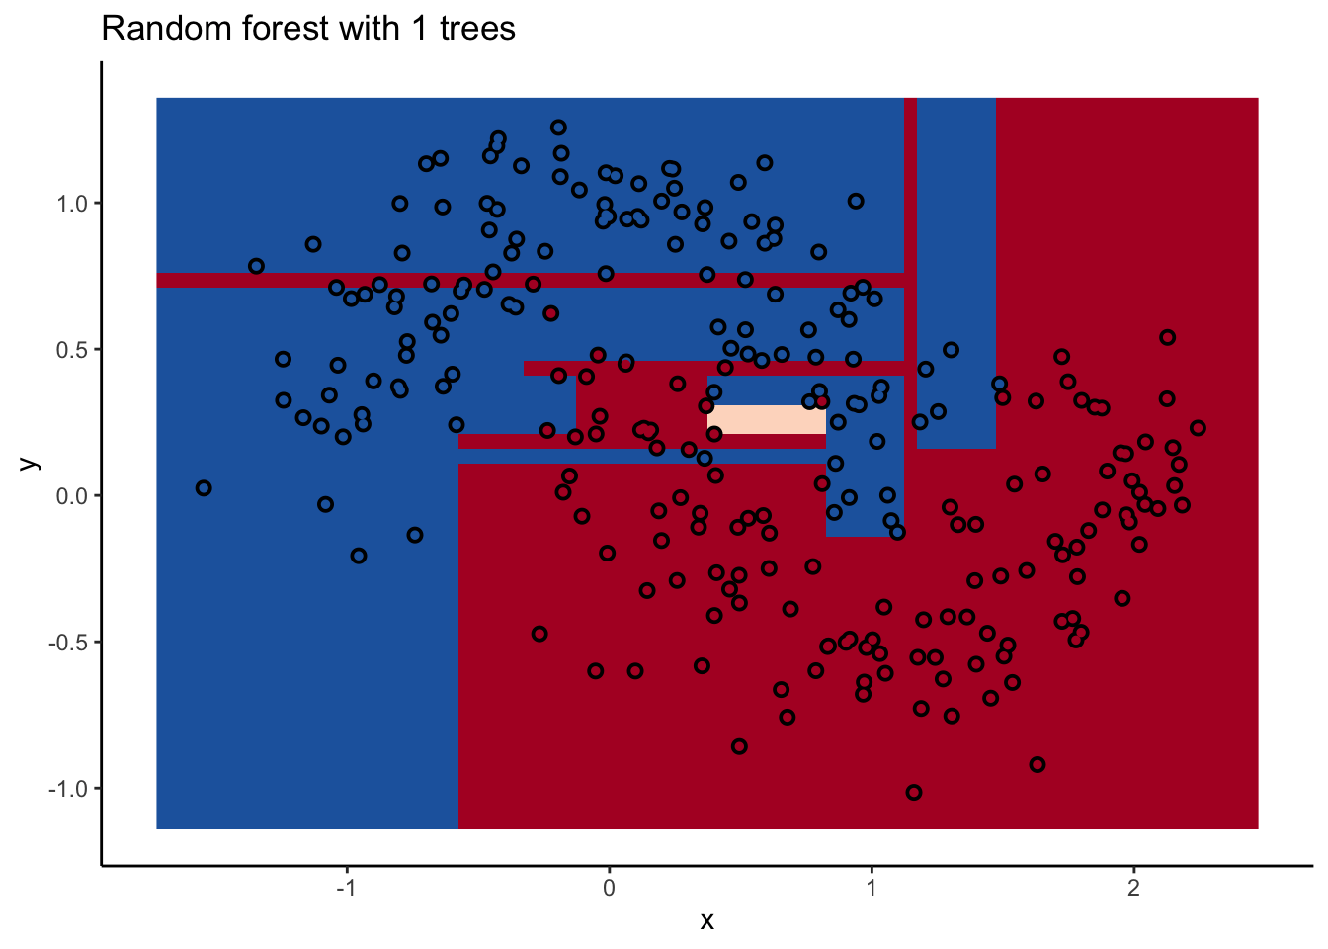
Random Forests
Decision Boundary of RF

Slide 14
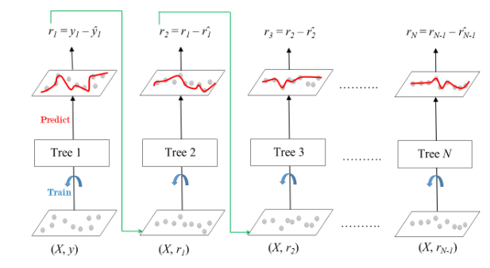
Boosted Trees (Boosting)
In boosting trees are grown sequentially.
Each tree is fit on a the residuals of the previous tree.

Slide 15
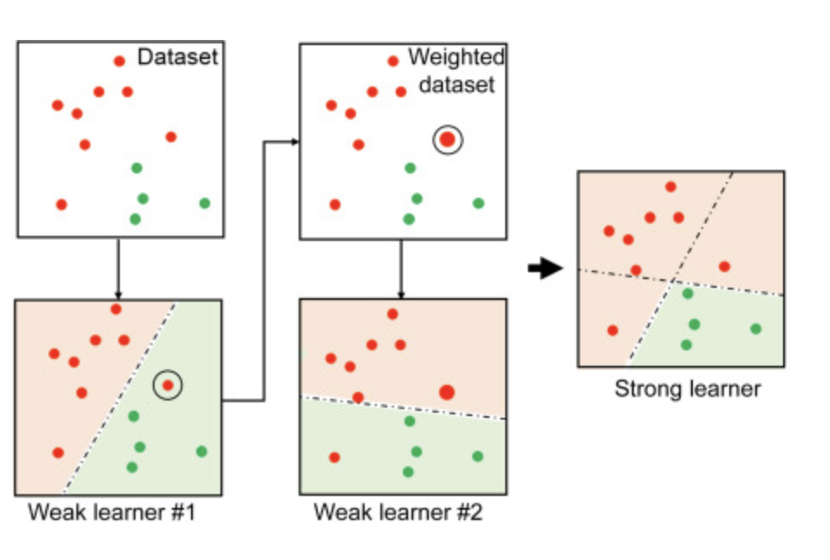
Boosted Trees (Boosting)
In boosting trees are grown sequentially.
Each tree is fit on a the residuals of the previous tree.

Slide 16
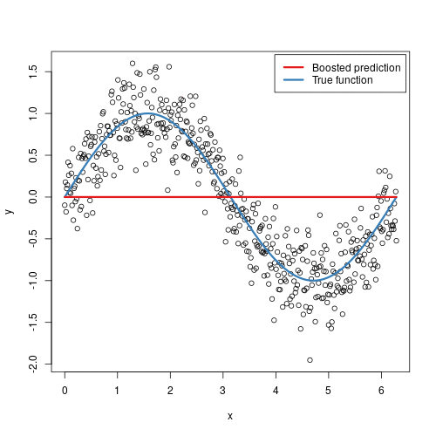
Boosted Trees (Boosting)
In boosting trees are grown sequentially.
Each tree is fit on a the residuals of the previous tree.

Slide 17
Python
Notes:
Guidelines
Use a title slide at the beginning of your presentation. There are 9 variations of title slides to choose from.
If you will have a series of slideshows, we recommend using the same style of title slide for each presentation.
Keep your title to no more than 2 lines.
Do not change the font style or font size of the title or subtitle.

Slide 18
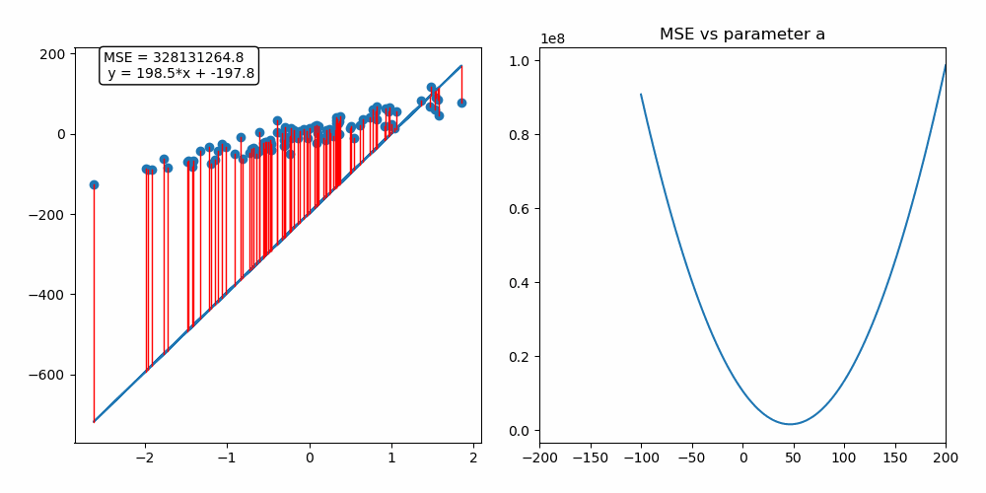
Gradient Boosting
Gradient descent is an optimization algorithm used to minimize some function by iteratively moving in the direction of steepest descent

Slide 19
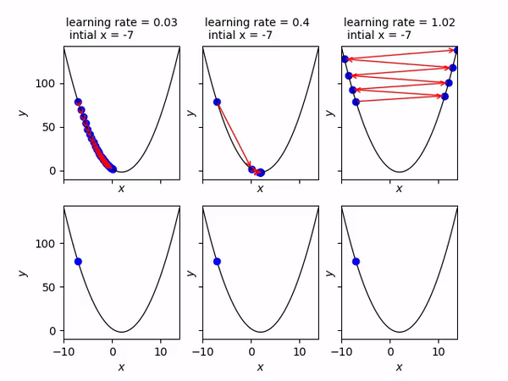
Gradient Boosting
Important hyper-parameter is the step size (learning rate)

Slide 20
Python
Notes:
Guidelines
Use a title slide at the beginning of your presentation. There are 9 variations of title slides to choose from.
If you will have a series of slideshows, we recommend using the same style of title slide for each presentation.
Keep your title to no more than 2 lines.
Do not change the font style or font size of the title or subtitle.

